Slide 1

TEAM CEREBRO
UpDown-Predicting Future Market Trends
Welcome to our presentation on predicting future trends in financial markets with AI. Today, we will explore how AI is revolutionizing the financial world and offer a powerful solution for making informed trading decisions.

Slide 2
Problem Statement
Price prediction in financial markets is highly volatile and prone to inaccuracies due to:
High market fluctuations and unpredictability.
Lack of transparency in prediction models.
Difficulty for users to verify the historical accuracy of predictions.

Slide 3
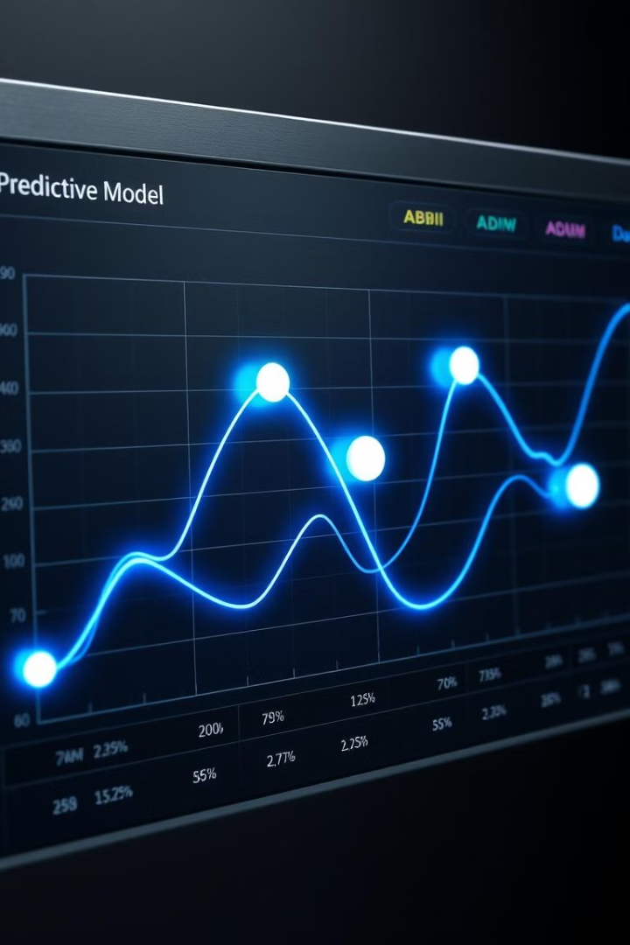
Proposed Solution
Develop a system that integrates machine learning for trend prediction with a blockchain-based record-keeping system to ensure transparency and trust.
Utilize historical market data and technical indicators to train an AI model capable of identifying price trends.
Provide users with real-time market graphs and predictions through an interactive interface

Slide 4
Methodology
Step 1: Data Collection:
APIs: CoinGecko, Binance and yfinance.
Data Type: Historical OHLCV data (Open, High, Low, Close, Volume) and derived technical indicators (e.g., RSI, SMA, MACD)
Step 2: Prediction and Calculation
Prediction: Predict the future trend (uptrend or downtrend) based on recent data.
Calculation: Based on the predicted uptrend or downtrend, the model will an output when its a good time to buy the coin/stock

Slide 5
Methodology
Step 3: Blockchain Integration
Purpose: Store model predictions and actual outcomes to provide a transparent record of the model’s accuracy.
Implementation:
Use a blockchain like Sepolia or Polygon Mumbai Testnet.
Store prediction records and timestamps in a smart contract.
Allow users to view the prediction history via the blockchain

Slide 6

Leveraging Blockchain for Transparency and Accountability
1
Each prediction is recorded on the blockchain, creating a tamper-proof audit trail. This ensures that the prediction process is transparent and accountable.
2
The blockchain's immutable nature safeguards the integrity of the data and protects against manipulation or alteration. Users can verify the accuracy of the predictions.

Slide 7
Tools and Techniques Used
Data Collection
CoinGecko API, Binance API, yfinance
Feature Engineering
ta, Pandas
Graph Integration
TradingView API
Blockchain Integration
Web3.js, Remix-ide
Frontend
HTML, CSS
Backend
Flask, Node.js

Slide 8
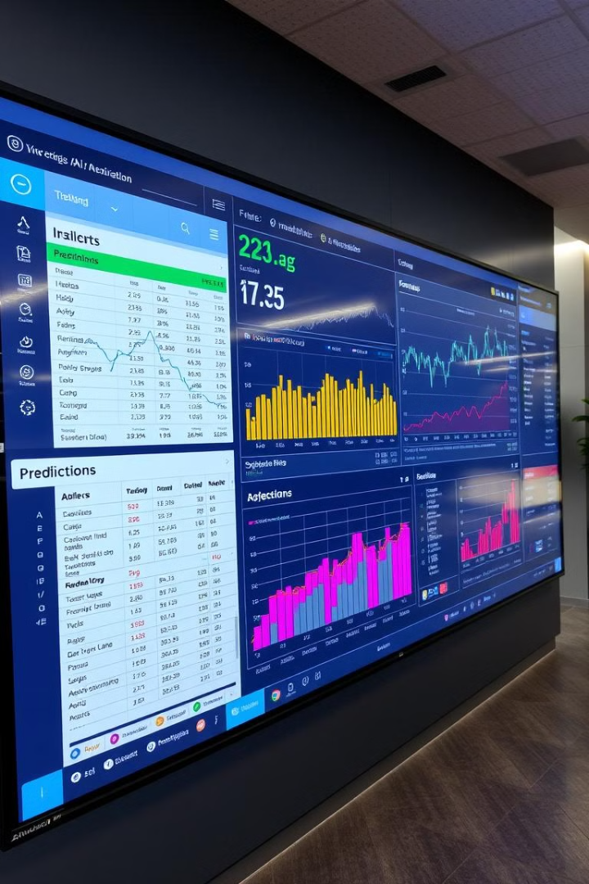
Future Enhancements
Integrate sentiment analysis to improve accuracy.
Add support for more assets.
Implement other indicators in order to improve accuracy of the prediction.

Slide 9
Results
We ran the tests overnight for ETHUSDT and BTCUSDT and we got the following results: For ETH:
It had a total of 20 buy orders and a total of 68 sell orders.
The average buy price for the orders came out to be $3644.52 and the average sell price came out to be $3653.61.
For BTC:
-It had a total of buy orders and a total of 2 sell orders.
-The average buy price for the orders came out to be $96283.53 and the average sell price came out to be $96374.71.
Hence we can observe that, at an average we have bought the coin at a lower price and sold it at a higher price,
usually for Futures trades we use a leverage, so at a high leverage of 25-30x , we will end up making a good
profit on our trades.

Slide 10
Changes made after the results.
Initially in the results we could see that the number of buy or sell orders were more in number compared to the other order due to market sentiments, so we made changes in the code such that a buy order is followed strictly by a sell order hence making it easier for us to calculate the profit/loss percentage and also calculate the accuracy of our project.
We integrated the blockchain component in the project such that every time a buy or a sell call is made, it gets pushed into the blockchain and hence be immutable forever maintaining transparency. But we didn’t have any further calls after the implementation hence we couldn’t generate any transactions as of now.
To compensate for it, we had made it so that all the calls were getting saved in a csv file which has logged in all the data we got overnight and is been attached in the github repository.

Slide 11
Future Scopes
Currently the model is checking if three of the five conditions are satisfied and hence a buy or a sell order is given as the output. If all five of the conditions are met, a Super Buy/ Super Sell call is made which will have the highest accuracy in all of the calls.
We have made the code such that we would get short term gains in order to show the results, but to make it more accurate we can increase the timeline of the indicators hence giving the code a bigger timeline to work on and hence create more accurate results.

Slide 12
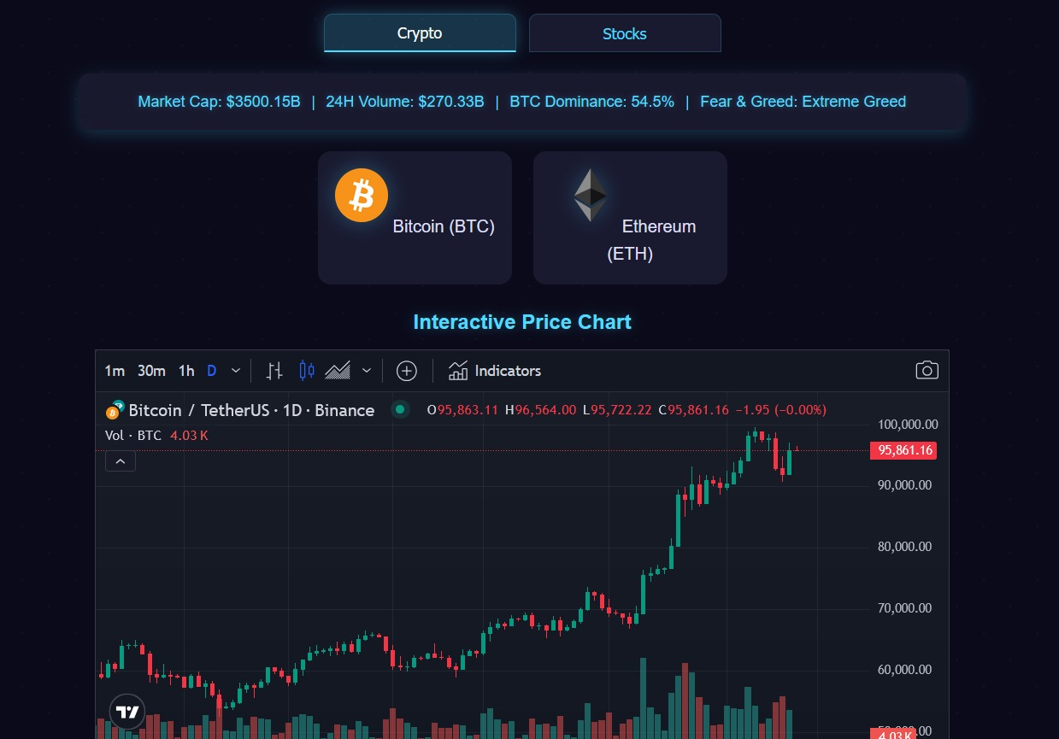
Working of the model

Slide 13
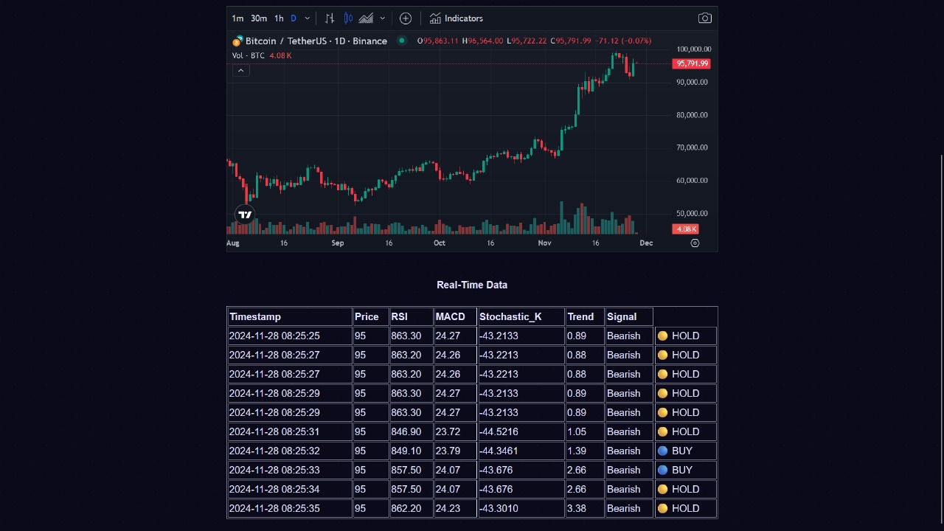
Working of the model

Slide 14
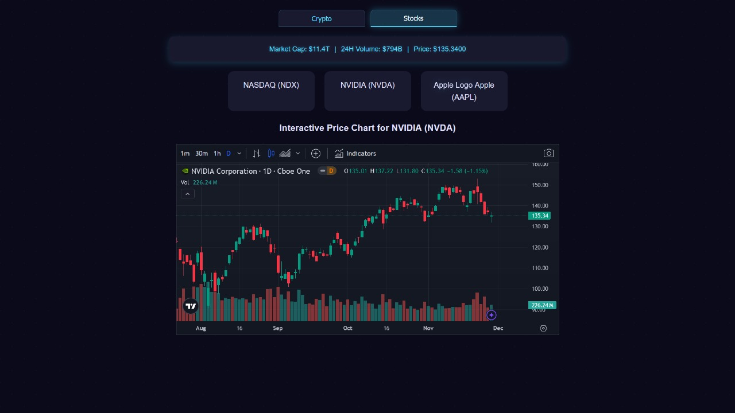
Working of the model

Slide 15
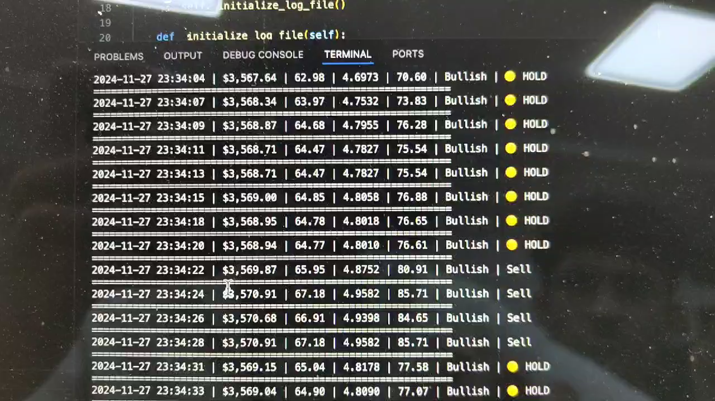
Working of the model
Click to Play the video

Slide 16
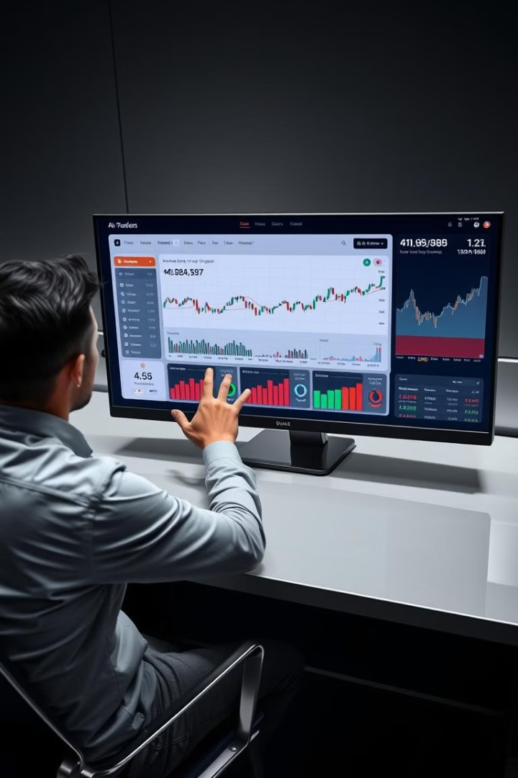
Conclusion
This project demonstrates a robust approach to leveraging AI and blockchain for financial market prediction, delivering transparency, accuracy, and ease of use. It bridges the gap between analytics and trust in trading predictions.

